Slide 1
Loading and Visualizing COVID-19 Data
Team Locode

Slide 2
Authentication and Schema – REST API

Slide 3
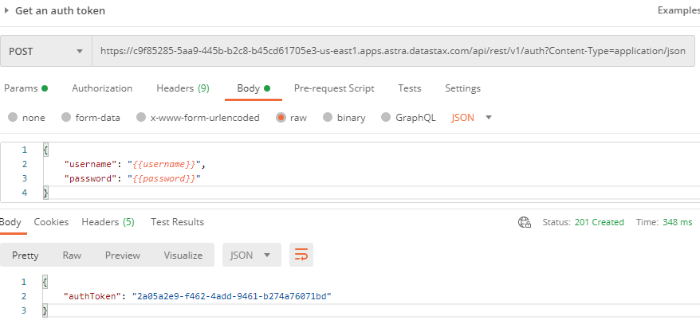
Postman: Get an auth token

Slide 4
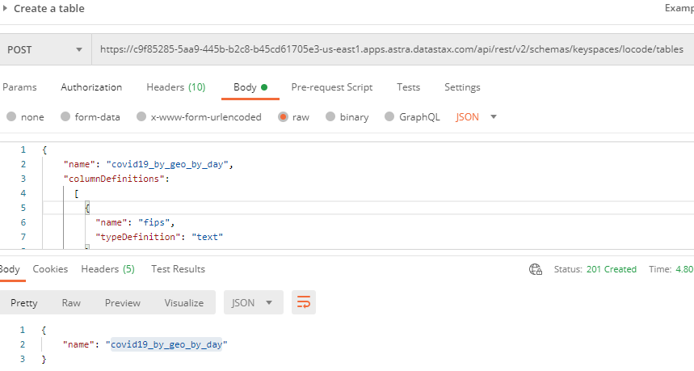
Postman: Create a table

Slide 5
Load Data – dsbulk

Slide 6
Windows Command Line: dsbulk for initial loading
dsbulk load ^
-url https://raw.githubusercontent.com/CSSEGISandData/COVID-19/master/csse_covid_19_data/csse_covid_19_daily_reports/03-31-2020.csv ^
-k locode ^
-t covid19_by_geo_by_day ^
-b "C://DataStax//secure-connect//secure-connect-locodedb.zip" ^
-u <username> ^
-p <password> ^
-header true ^
-m "FIPS=fips,Admin2=admin2,Province_State=province_state,Country_Region=country_region,Last_Update=last_update, Lat=lat,Long_=long_,Confirmed=confirmed,Deaths=deaths,Recovered=recovered,Active=active,Combined_Key=combined_key"
Username and password provided but auth provider not specified, inferring PlainTextAuthProvider
A cloud secure connect bundle was provided: ignoring all explicit contact points.
A cloud secure connect bundle was provided and selected operation performs writes: changing default consistency level to LOCAL_QUORUM.
Operation directory: C:\DataStax\dsbulk-1.7.0\bin\logs\LOAD_20201012-193450-056000
total | failed | rows/s | p50ms | p99ms | p999ms | batches
2,434 | 0 | 843 | 1,053.55 | 1,174.41 | 1,174.41 | 9.55
Operation LOAD_20201012-193450-056000 completed successfully in 1 second.
Last processed positions can be found in positions.txt

Slide 7
Test Loaded Data – REST API

Slide 8
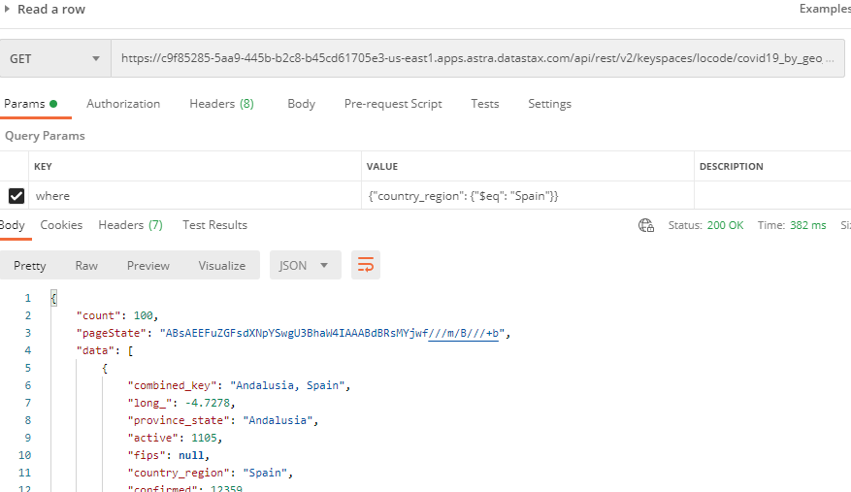
Postman: Get a row

Slide 9
BI Tool – JDBC Driver

Slide 10
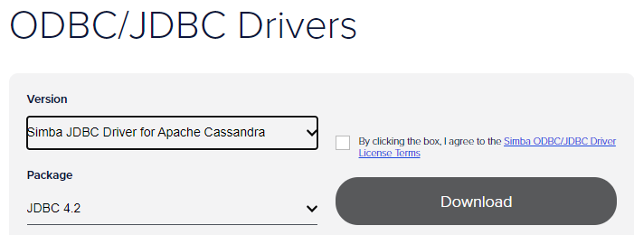
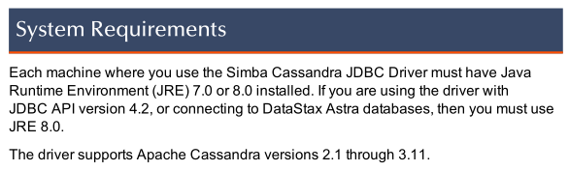
Download / Install
Review the documentation
Put a copy of the jdbc.jar file in the appropriate folder for Oracle Anaytics Desktop
C:\Program Files\Oracle Analytics Desktop\lib\CassandraJDBC42.jar

Slide 11
BI Tool – Oracle Analytics Desktop

Slide 12
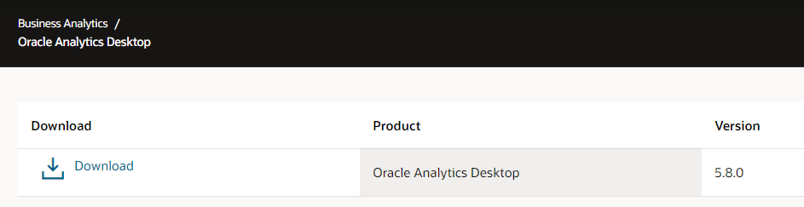
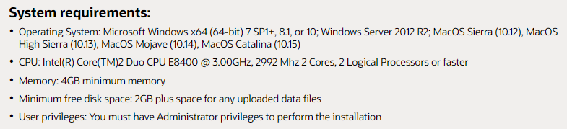
Download / Install
https://www.oracle.com/solutions/business-analytics/analytics-desktop/oracle-analytics-desktop.html

Slide 13
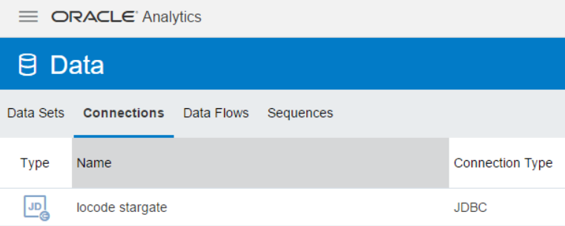
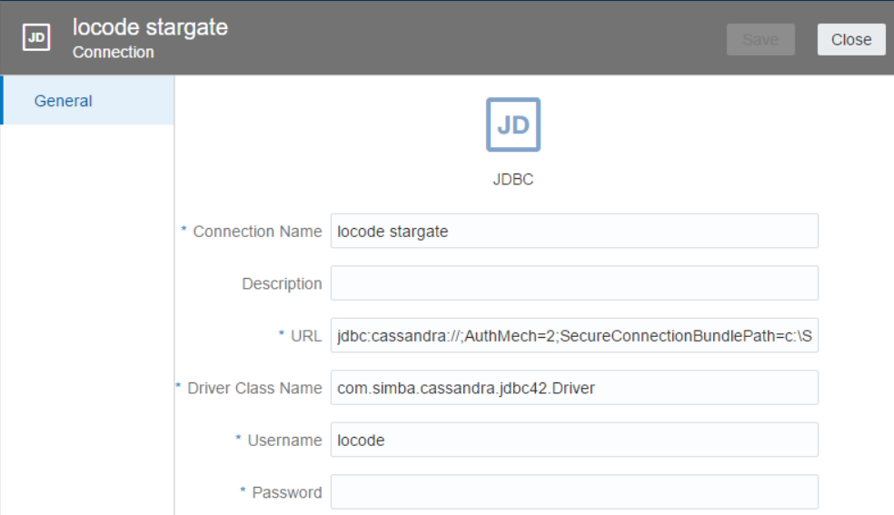
Data Connection
Property | Value
Connection Name | Any name will do … locode stargate
URL | jdbc:cassandra://;AuthMech=2;SecureConnectionBundlePath=c:\SAM\Astra\secure-connect-sams-astra-cluster.zip
Driver class name | com.simba.cassandra.jdbc42.Driver

Slide 14
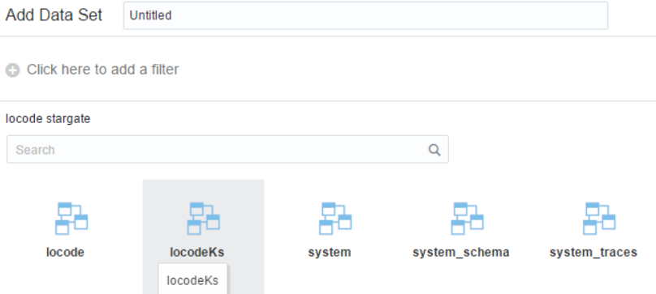
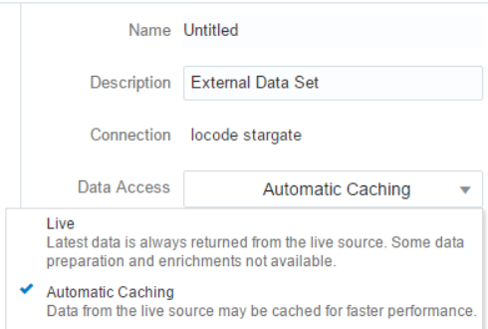
Adding Data Set
Select your keyspace (and then table/s)
Select Data Access options of Live or Automatic Cachine

Slide 15
Adding Data Set
Select your keyspace (and then table/s)
Select Data Access options of Live or Automatic Cachine
Select columns and do some “prep”
Optional: add various lookup/enrichment data per Country and/or State

Slide 16
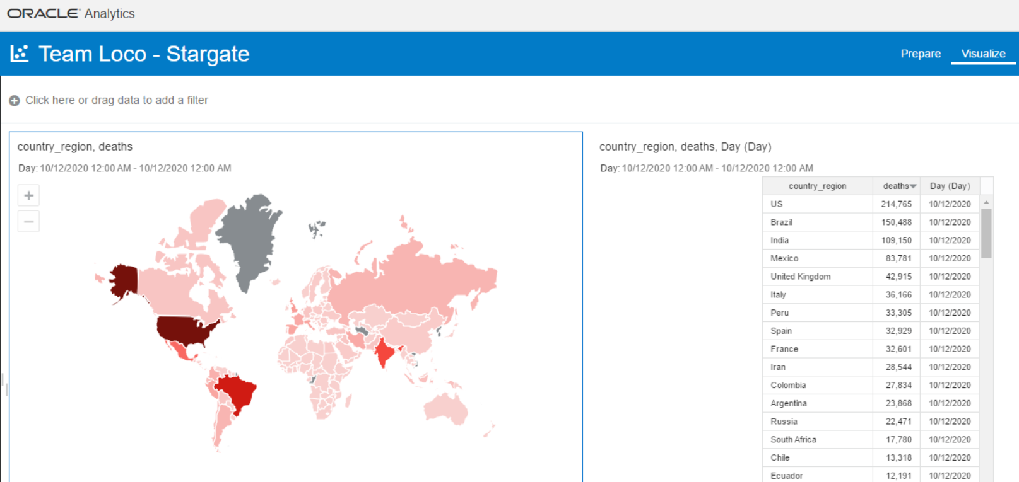
Sample Data Visualizations By Country

Slide 17
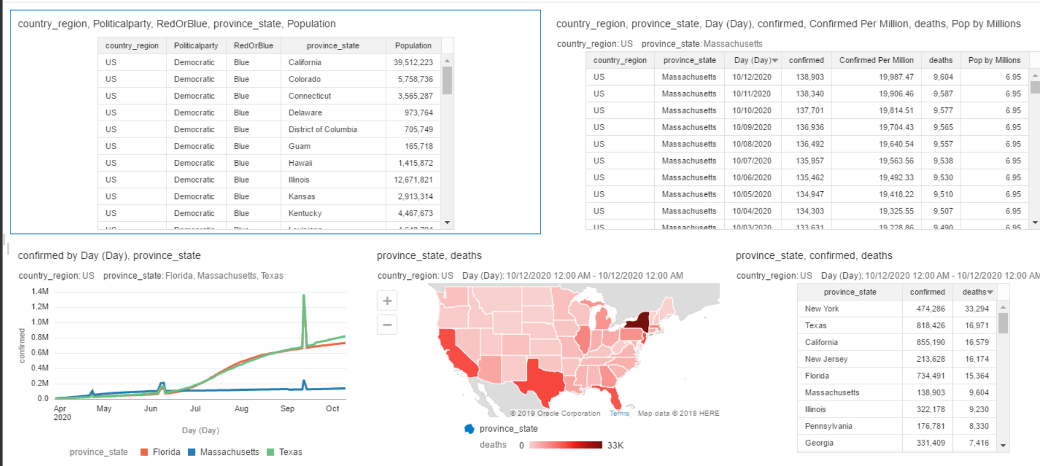
Sample Data Visualizations for the US

